Slide 1
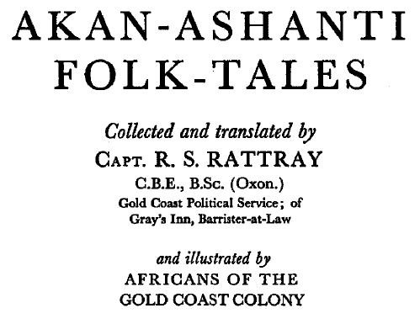
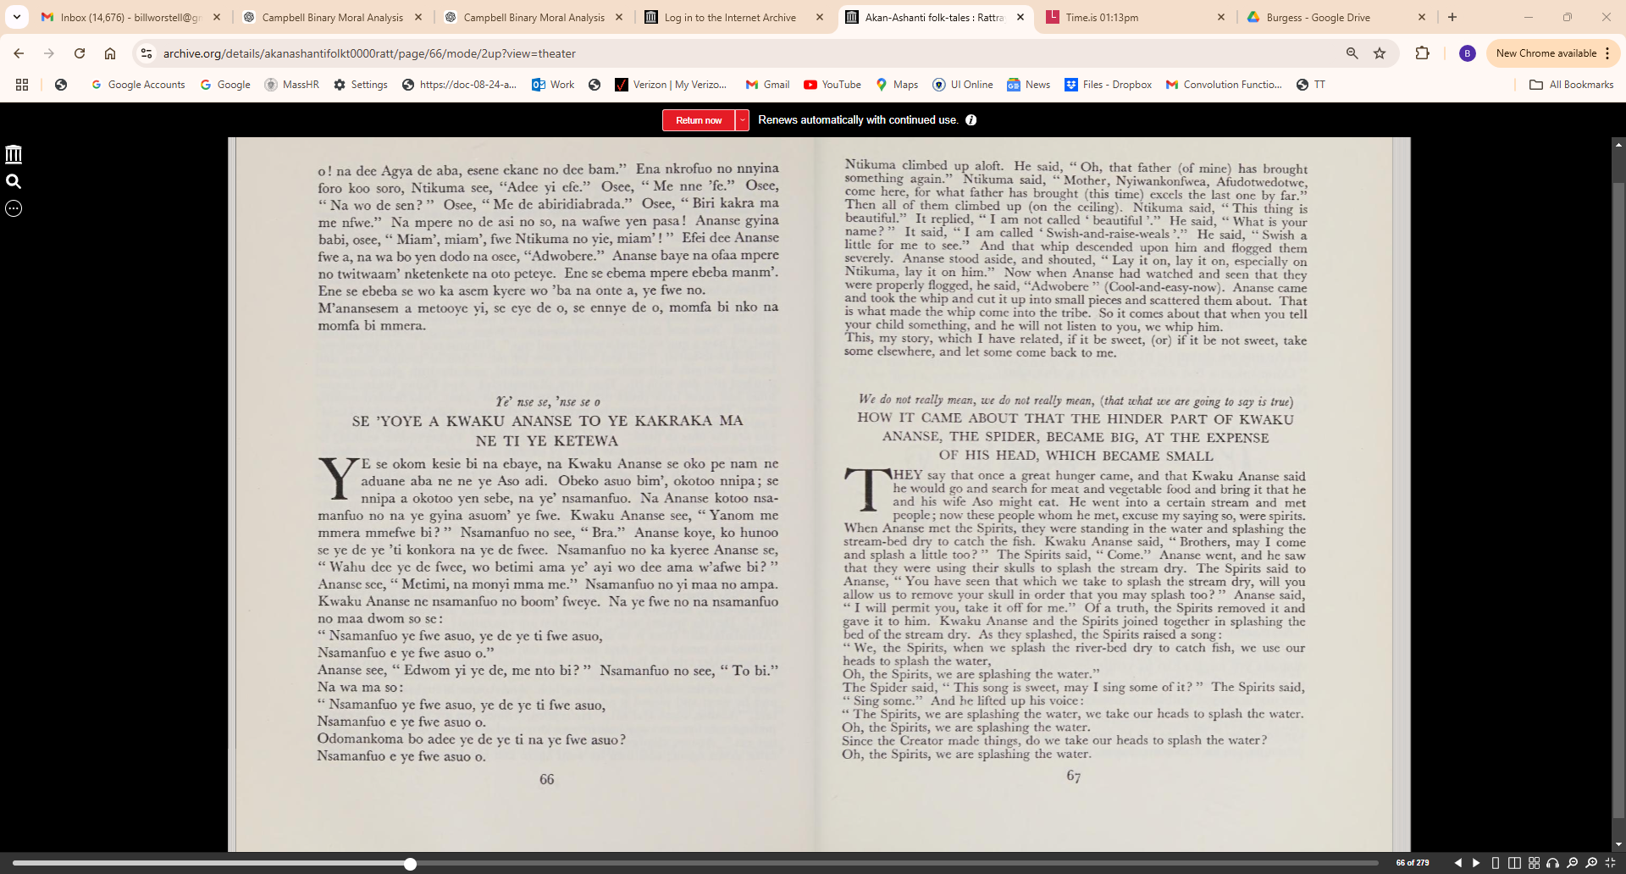

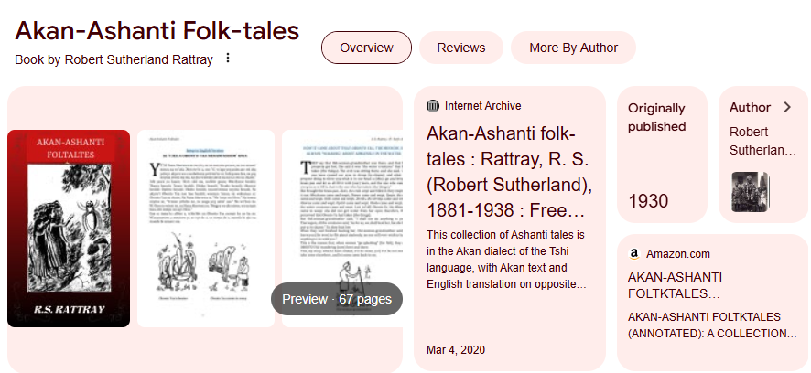
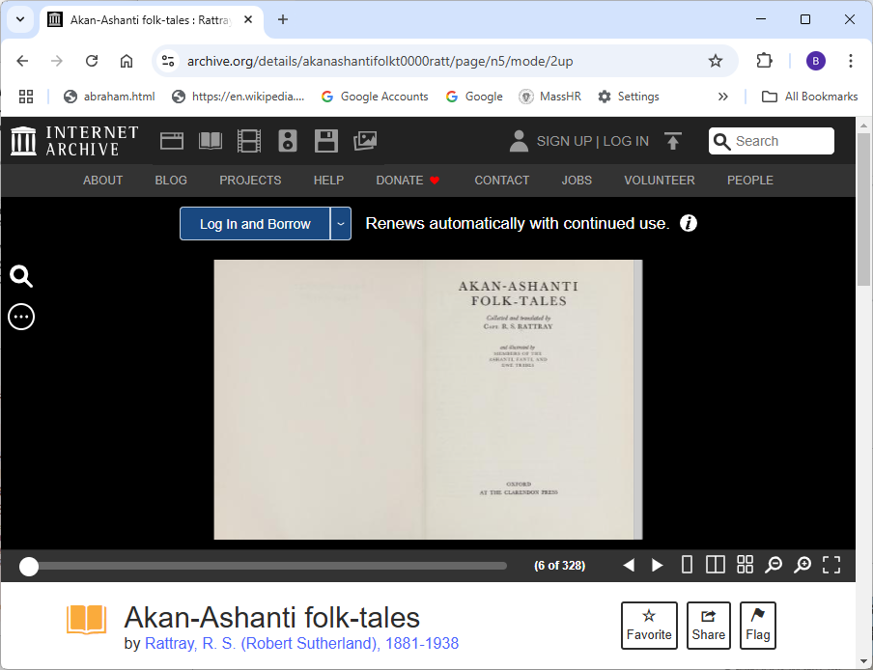
Demo Source Material:
https://archive.org/details/akanashantifolkt0000ratt/page/n5/mode/2up

Slide 3
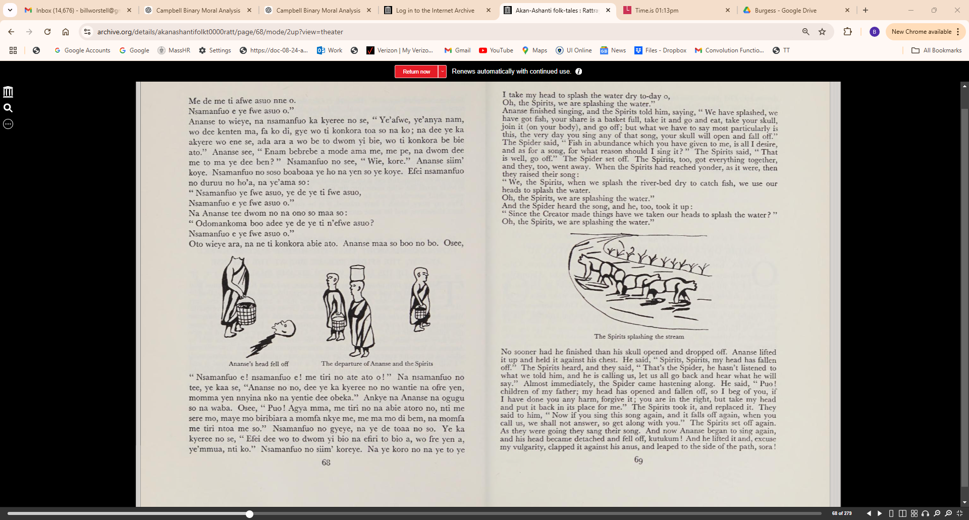

Slide 4
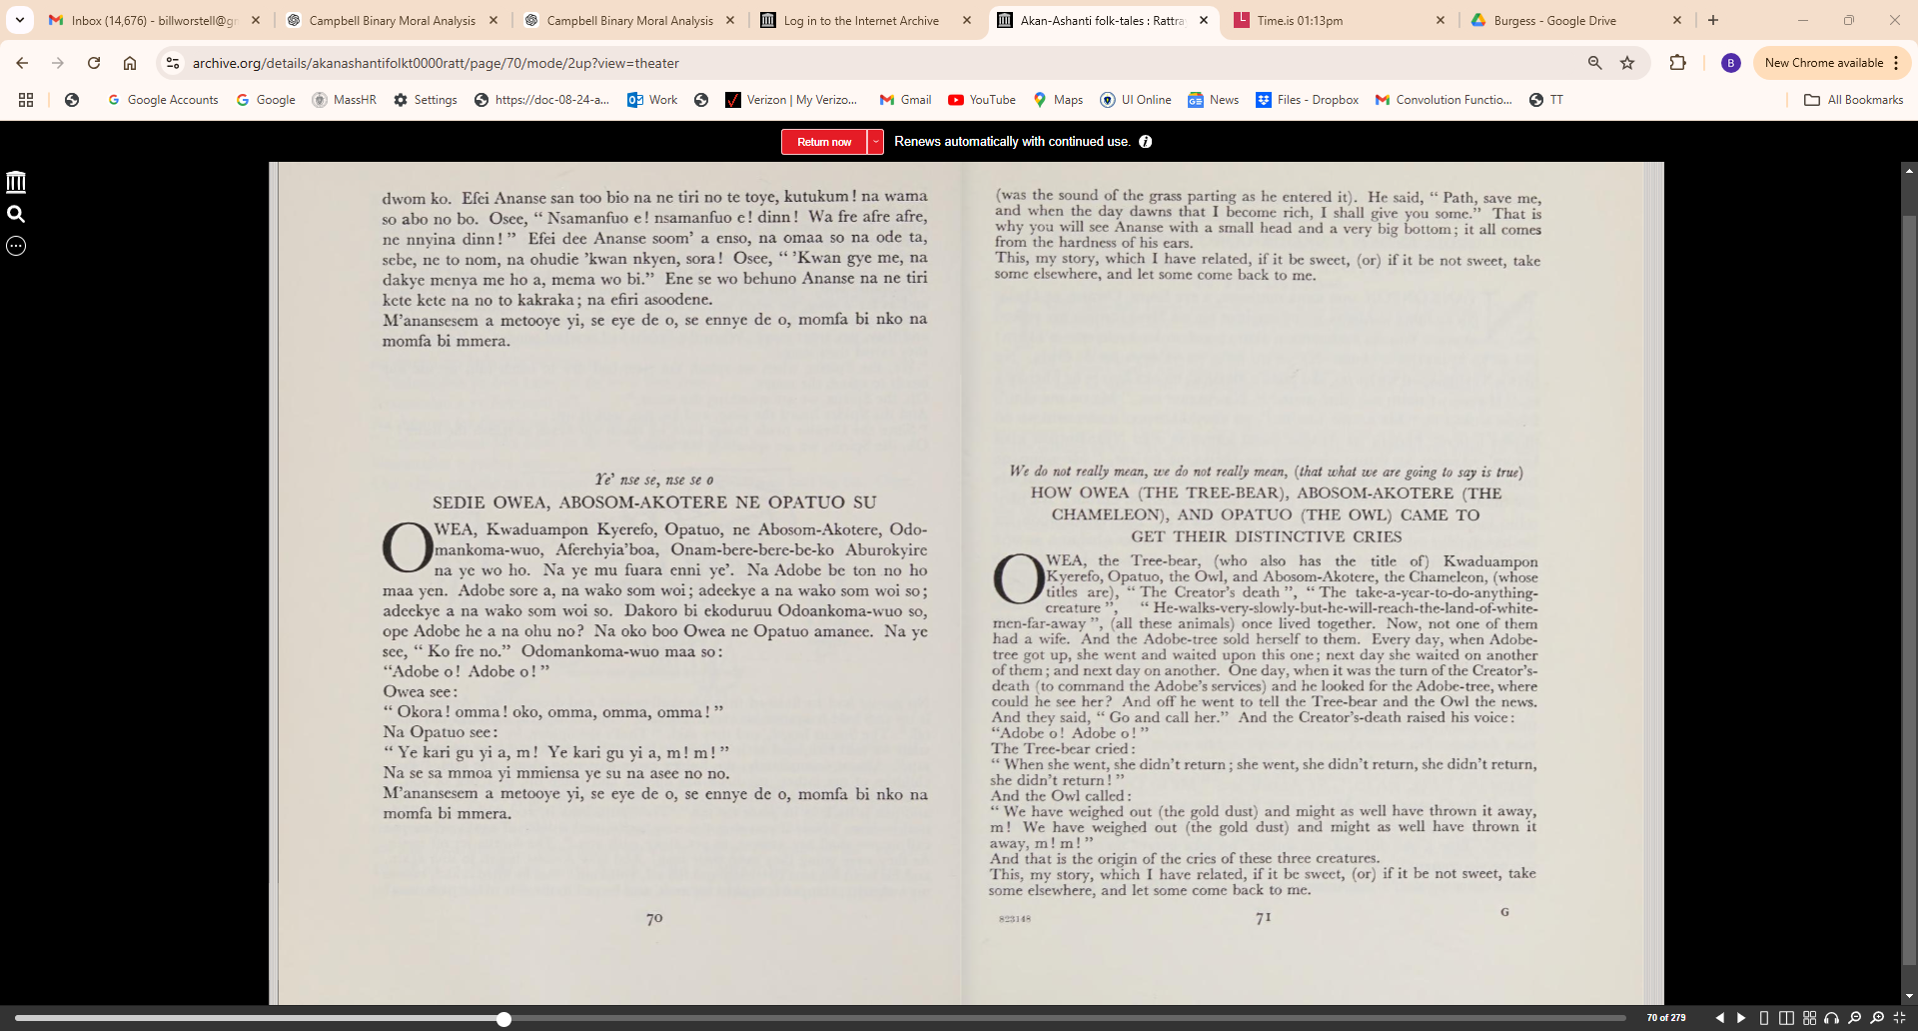

Slide 6
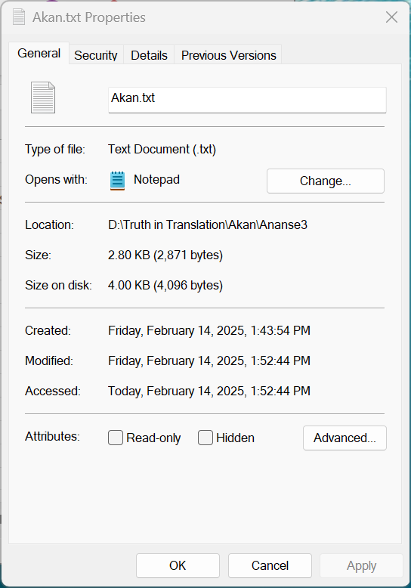
Ye’ nse se, 'nse se o
SE 'YOYE A KWAKU ANANSE TO YE KAKRAKA MA NE TI YE KETEWA
YE se okom kesie bi na ebaye, na Kwaku Ananse se oko pe nam ne aduane aba ne ne ye Aso adi. Obeko asuo bim', okotoo nnipa; se nnipa a okotoo yen sebe, na ye' nsamanfuo. Na Ananse kotoo nsa­
manfuo no na ye gyina asuom' ye fwe. Kwaku Ananse see, "Yanom me mmera mmefwe bi?" Nsamanfuo no see, "Bra." Ananse koye, ko hunoo se ye de ye 'ti konkora na ye de fwee. Nsamanfuo no ka kyeree Ananse se, "Wahu dee ye de fwee, wo betimi ama ye' ayi wo dee ama w'afwe bi? " Ananse see, " Metimi, na monyi mma me." Nsamanfuo no yi maa no ampa. Kwaku Ananse ne nsamanfuo no boom' fweye. Na ye fwe no na nsamanfuo no maa dwom so se:
" Nsamanfuo ye fwe asuo, ye de ye ti fwe asuo, Nsamanfuo eye fwe asuo o."
Ananse see, " Edwom yi ye de, me nto bi? " Nsamanfuo no see, " To bi." Na wa ma so:
" Nsamanfuo ye fwe asuo, ye de ye ti fwe asuo, Nsamanfuo e ye fwe asuo o.
Odomankoma ho adee ye de ye ti na ye fwe asuo?
Nsamanfuo e ye fwe asuo o.
Me de me ti afwe asuo nne o.
Nsamanfuo e ye fwe asuo o."
Ananse to wieye, na nsamanfuo ka kyeree no se, "Ye'afwe, ye'anya nam,
wo dee kenten ra, fa ko di, gye wo ti konkora toa so na ko; na dee ye ka
akyere wo ene se, ada ara a wo be to dwom yi- bie, wo ti konkora be bie
ato." Ananse see, "Enam bebrebe a mode ama me, me pe, na dwom dee
me to ma ye dee ben? " Nsamanfuo no see, "Wie, kore." Ananse sim'
koye. Nsamanfuo no soso boaboaa ye ho na yen so ye koye. Efei nsamanfuo
no duruu no ho'a, na ye'ama so:
"Nsamanfuo ye fwe asuo, ye de ye ti fwe asuo,
Nsamanfuo e ye fwe asuo o."
Na Ananse tee dwom no na ono so maa so:
" Odomankoma boo adee ye de ye ti n'efwe asuo?
Nsamanfuo e ye fwe asuo o."
Oto wieye ara, na ne ti konkora abie ato. Ananse maa so boo no bo. Osee,
"Nsamanfuo e! nsamanfuo e! me tiri no ate ato o!" Na nsamanfuo no
tee, ye kaa se, "Ananse no no, dec ye ka kyeree no no wantie na ofre yen,
momma yen nnyina nko na yentie dee obeka." Ankye na Ananse na ogugu
so na waba. Osee, "Puo! Agya mma, me tiri no na abie atoro no, nti me
sere mo, maye mo biribiara a momfa nkye me, me ma mo di bem, na momfa
me tiri ntoa me so." Nsamanfuo no gyeye, na ye de toaa no so. Ye ka
kyeree no se, "Efei dee wo to dwom yi bio na efiri to bio a, wo fre yen a,
ye'mmua, nti ko." Nsamanfuo no siim' koreye. Na ye koro no na ye to ye
dwom ko. Efei Ananse san too bio na ne tiri no te toye, kutukum! na wama
so abo no bo. Osce, " Nsamanfuo e! nsamanfuo e! dinn! Wa fre afre afre,
ne nnyina dinn! " Efei dee Ananse soom' a enso, na omaa so na ode ta,
sebe, ne to nom, na ohudie 'kwan nkyen, sora! Osee, " 'Kwan gye me, na
dakye menya me ho a, mema wo bi." Ene se wo behuno Ananse na ne tiri
kete kete na no to kakraka; na efiri asoodene.
M'anansesem a metooye yi, se eye de o, se ennye de o, momfa bi nko na
momfa bi mmera.

Slide 7
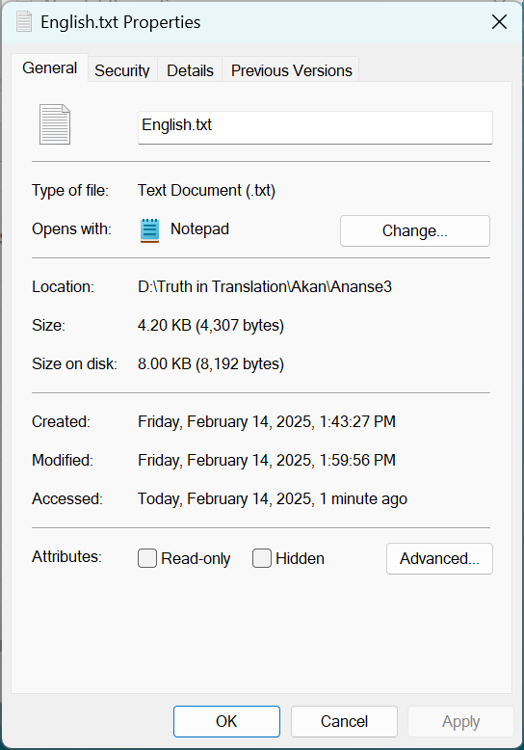
We do not really mean, we do not really mean, (that what we are going to say is true)
HOW IT CAME ABOUT THAT THE HINDER PART OF KWAKU
ANANSE, THE SPIDER, BECAME BIG, AT THE EXPENSE
OF HIS HEAD, WHICH BECAME SMALL
THEY say that once a great hunger came, and that Kwaku Ananse said
he would go and search for meat and vegetable food and bring it that he
and his wife Aso might eat. He went into a certain stream and met
people; now these people whom he met, excuse my saying so, were spirits.
When Ananse met the Spirits, they were standing in the water and splashing the
stream-bed dry to catch the fish. Kwaku Ananse said, " Brothers, may I come
and splash a little too? " The Spirits said, " Come." Ananse went, and he saw
that they were using their skulls to splash the stream dry. The Spirits said to
Ananse, " You have seen that which we take to splash the stream dry, will you
allow us to remove your skull in order that you may splash too? " Ananse said,
" I will permit you, take it off for me." Of a truth, the Spirits removed it and
gave it to him. Kwaku Ananse and the Spirits joined together in splashing the
bed of the stream dry. As they splashed, the Spirits raised a song:
" We, the Spirits, when we splash the river-bed dry to catch fish, we use our
heads to splash the water,
Oh, the Spirits, we are splashing the water."
The Spider said, "This song is sweet, may I sing some of it? " The Spirits said,
" Sing some." And he lifted up his voice:
" The Spirits, we are splashing the water, we take our heads to splash the water.
Oh, the Spirits, we are splashing the water.
Since the Creator made things, do we take our heads to splash the water?
Oh, the Spirits, we are splashing the water.
I take my head to splash the water dry to-day o,
Oh, the Spirits, we are splashing the water."
Ananse finished singing, and the Spirits told him, saying, "We have splashed, we
have got fish, your share is a basket full, take it and go and eat, take your skull,
join it (on your body), and go off; but what we have to say most particularly is
this, the very day you sing any of that song, your skull will open and fall off."
The Spider said, "Fish in abundance which you have given to me, is all I desire,
and as for a song, for what reason should I sing it? " The Spirits said, "That
is well, go off." The Spider set off. The Spirits, too, got everything together,
and they, too, went away. When the Spirits had reached yonder, as it were, then
they raised their song:
"We, the Spirits, when we splash the river-bed dry to catch fish, we use our
heads to splash the water.
Oh, the Spirits, we are splashing the water."
And the Spider heard the song, and he, too, took it up:
" Since the Creator made things have we taken our heads to splash the water?"
Oh, the Spirits, we are splashing the water.“
No sooner had he finished than his skull opened and dropped off. Ananse lifted
it up and held it against his chest. He said, " Spirits, Spirits, my head has fallen
off." The Spirits heard, and they said, "That's the Spider, he hasn't listened to
what we told him, and he is calling us, let us all go back and hear what he will
say." Almost immediately, the Spider came hastening along. He said, " Puo!
children of my father; my head has opened and fallen off, so I beg of you, if
I have done you any harm, forgive it; you are in the right, but take my head
and put it back in its place for me." The Spirits took it, and replaced it. They
said to him, "Now if you sing this song again, and it falls off again, when you
call us, we shall not answer, so get along with you." The Spirits set off again.
As they were going they sang their song. And now Ananse began to sing again,
and his head became detached and fell off, kutukum! And he lifted it and, excuse
my vulgarity, clapped it against his anus, and leaped to the side of the path, sora!
was the sound of the grass parting as he entered it). He said, " Path, save me,
and when the day dawns that I become rich, I shall give you some." That is
why you will see Ananse with a small head and a very big bottom; it all comes
from the hardness of his ears.
This, my story, which I have related, if it be sweet, (or) if it be not sweet, take
some elsewhere, and let some come back to me.

Slide 8
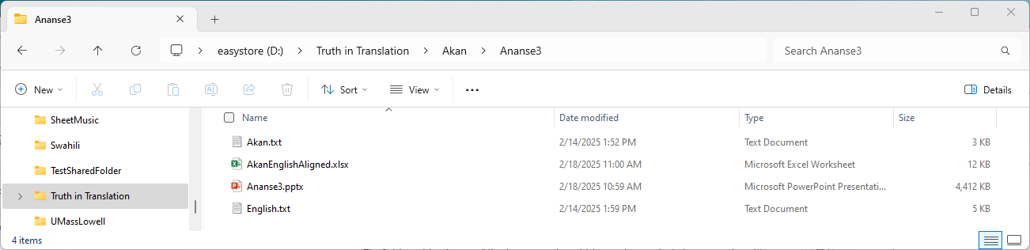
----- GPT-3.5-turbo Estimate ----- Prompt tokens: 2422 Completion tokens (est): 200 Approx total tokens: 2622 Prompt cost: $0.0036 Completion cost: $0.0004 Total cost (est): $0.0040 ----- GPT-4 Estimate ----- Prompt tokens: 2422 Completion tokens (est): 200 Approx total tokens: 2622 Prompt cost: $0.0727 Completion cost: $0.0120 Total cost (est): $0.0847 Number of aligned sentence pairs: 18
----- GPT-3.5-turbo Estimate -----
Prompt tokens: 2422
Completion tokens (est): 200
Approx total tokens: 2622
Prompt cost: $0.0036
Completion cost: $0.0004
Total cost (est): $0.0040
----- GPT-4 Estimate -----
Prompt tokens: 2422
Completion tokens (est): 200
Approx total tokens: 2622
Prompt cost: $0.0727
Completion cost: $0.0120
Total cost (est): $0.0847
Number of aligned sentence pairs: 18

Slide 9
AKAN | ENGLISH
Ye' nse se, 'nse se o | We do not really mean, we do not really mean, (that what we are going to say is true)
SE 'YOYE A KWAKU ANANSE TO YE KAKRAKA MA NE TI YE KETEWA | HOW IT CAME ABOUT THAT THE HINDER PART OF KWAKU ANANSE, THE SPIDER, BECAME BIG, AT THE EXPENSE OF HIS HEAD, WHICH BECAME SMALL
YE se okom kesie bi na ebaye, na Kwaku Ananse se oko pe nam ne aduane aba ne ne ye Aso adi. Obeko asuo bim', okotoo nnipa; se nnipa a okotoo yen sebe, na ye' nsamanfuo. | THEY say that once a great hunger came, and that Kwaku Ananse said he would go and search for meat and vegetable food and bring it that he and his wife Aso might eat. He went into a certain stream and met people; now these people whom he met, excuse my saying so, were spirits.
Na Ananse kotoo nsa­manfuo no na ye gyina asuom' ye fwe. Kwaku Ananse see, "Yanom me mmera mmefwe bi?" Nsamanfuo no see, "Bra." Ananse koye, ko hunoo se ye de ye 'ti konkora na ye de fwee. | When Ananse met the Spirits, they were standing in the water and splashing the stream-bed dry to catch the fish. Kwaku Ananse said, " Brothers, may I come and splash a little too? " The Spirits said, " Come." Ananse went, and he saw that they were using their skulls to splash the stream dry.
Nsamanfuo no ka kyeree Ananse se, "Wahu dee ye de fwee, wo betimi ama ye' ayi wo dee ama w'afwe bi? " Ananse see, " Metimi, na monyi mma me." Nsamanfuo no yi maa no ampa. Kwaku Ananse ne nsamanfuo no boom' fweye. | The Spirits said to Ananse, " You have seen that which we take to splash the stream dry, will you allow us to remove your skull in order that you may splash too? " Ananse said, " I will permit you, take it off for me." Of a truth, the Spirits removed it and gave it to him. Kwaku Ananse and the Spirits joined together in splashing the bed of the stream dry.
Na ye fwe no na nsamanfuo no maa dwom so se: " Nsamanfuo ye fwe asuo, ye de ye ti fwe asuo, Nsamanfuo eye fwe asuo o." | As they splashed, the Spirits raised a song: " We, the Spirits, when we splash the river-bed dry to catch fish, we use our heads to splash the water, Oh, the Spirits, we are splashing the water."
Ananse see, " Edwom yi ye de, me nto bi? " Nsamanfuo no see, " To bi." Na wa ma so: " Nsamanfuo ye fwe asuo, ye de ye ti fwe asuo, Nsamanfuo e ye fwe asuo o. Odomankoma ho adee ye de ye ti na ye fwe asuo? Nsamanfuo e ye fwe asuo o.Me de me ti afwe asuo nne o. Nsamanfuo e ye fwe asuo o." | The Spider said, "This song is sweet, may I sing some of it? " The Spirits said, " Sing some." And he lifted up his voice: " The Spirits, we are splashing the water, we take our heads to splash the water. Oh, the Spirits, we are splashing the water. Since the Creator made things, do we take our heads to splash the water? Oh, the Spirits, we are splashing the water. I take my head to splash the water dry to-day o, Oh, the Spirits, we are splashing the water."
Ananse to wieye, na nsamanfuo ka kyeree no se, "Ye'afwe, ye'anya nam, wo dee kenten ra, fa ko di, gye wo ti konkora toa so na ko; na dee ye ka akyere wo ene se, ada ara a wo be to dwom yi- bie, wo ti konkora be bie ato." | Ananse finished singing, and the Spirits told him, saying, "We have splashed, we have got fish, your share is a basket full, take it and go and eat, take your skull, join it (on your body), and go off; but what we have to say most particularly is this, the very day you sing any of that song, your skull will open and fall off."
Ananse see, "Enam bebrebe a mode ama me, me pe, na dwom dee me to ma ye dee ben? " Nsamanfuo no see, "Wie, kore." Ananse sim' koye. Nsamanfuo no soso boaboaa ye ho na yen so ye koye. | The Spider said, "Fish in abundance which you have given to me, is all I desire, and as for a song, for what reason should I sing it? " The Spirits said, "That is well, go off." The Spider set off. The Spirits, too, got everything together, and they, too, went away.
Efei nsamanfuo no duruu no ho'a, na ye'ama so: "Nsamanfuo ye fwe asuo, ye de ye ti fwe asuo, Nsamanfuo e ye fwe asuo o." | When the Spirits had reached yonder, as it were, then they raised their song: "We, the Spirits, when we splash the river-bed dry to catch fish, we use our heads to splash the water. Oh, the Spirits, we are splashing the water."
Na Ananse tee dwom no na ono so maa so: " Odomankoma boo adee ye de ye ti n'efwe asuo? Nsamanfuo e ye fwe asuo o." | And the Spider heard the song, and he, too, took it up: " Since the Creator made things have we taken our heads to splash the water? Oh, the Spirits, we are splashing the water.“
Oto wieye ara, na ne ti konkora abie ato. Ananse maa so boo no bo. Osee, "Nsamanfuo e! nsamanfuo e! me tiri no ate ato o!" Na nsamanfuo no tee, ye kaa se, "Ananse no no, dec ye ka kyeree no no wantie na ofre yen, momma yen nnyina nko na yentie dee obeka." | No sooner had he finished than his skull opened and dropped off. Ananse lifted it up and held it against his chest. He said, " Spirits, Spirits, my head has fallen off." The Spirits heard, and they said, "That's the Spider, he hasn't listened to what we told him, and he is calling us, let us all go back and hear what he will say."
Ankye na Ananse na ogugu so na waba. Osee, "Puo! Agya mma, me tiri no na abie atoro no, nti me sere mo, maye mo biribiara a momfa nkye me, me ma mo di bem, na momfa me tiri ntoa me so." | Almost immediately, the Spider came hastening along. He said, " Puo! children of my father; my head has opened and fallen off, so I beg of you, if I have done you any harm, forgive it; you are in the right, but take my head and put it back in its place for me."
Nsamanfuo no gyeye, na ye de toaa no so. Ye ka kyeree no se, "Efei dee wo to dwom yi bio na efiri to bio a, wo fre yen a, ye'mmua, nti ko." Nsamanfuo no siim' koreye. | The Spirits took it, and replaced it. They said to him, "Now if you sing this song again, and it falls off again, when you call us, we shall not answer, so get along with you." The Spirits set off again.
Na ye koro no na ye to ye dwom ko. Efei Ananse san too bio na ne tiri no te toye, kutukum! na wama so abo no bo. Osce, " Nsamanfuo e! nsamanfuo e! dinn! Wa fre afre afre, ne nnyina dinn! " | As they were going they sang their song. And now Ananse began to sing again, and his head became detached and fell off, kutukum! And he lifted it and, excuse my vulgarity, clapped it against his anus, and leaped to the side of the path, sora!
Efei dee Ananse soom' a enso, na omaa so na ode ta, sebe, ne to nom, na ohudie 'kwan nkyen, sora! Osee, " 'Kwan gye me, na dakye menya me ho a, mema wo bi." | was the sound of the grass parting as he entered it). He said, " Path, save me, and when the day dawns that I become rich, I shall give you some."
Ene se wo behuno Ananse na ne tiri kete kete na no to kakraka; na efiri asoodene. | That is why you will see Ananse with a small head and a very big bottom; it all comes from the hardness of his ears.
M'anansesem a metooye yi, se eye de o, se ennye de o, momfa bi nko na momfa bi mmera. | This, my story, which I have related, if it be sweet, (or) if it be not sweet, take some elsewhere, and let some come back to me.

